Slide 1
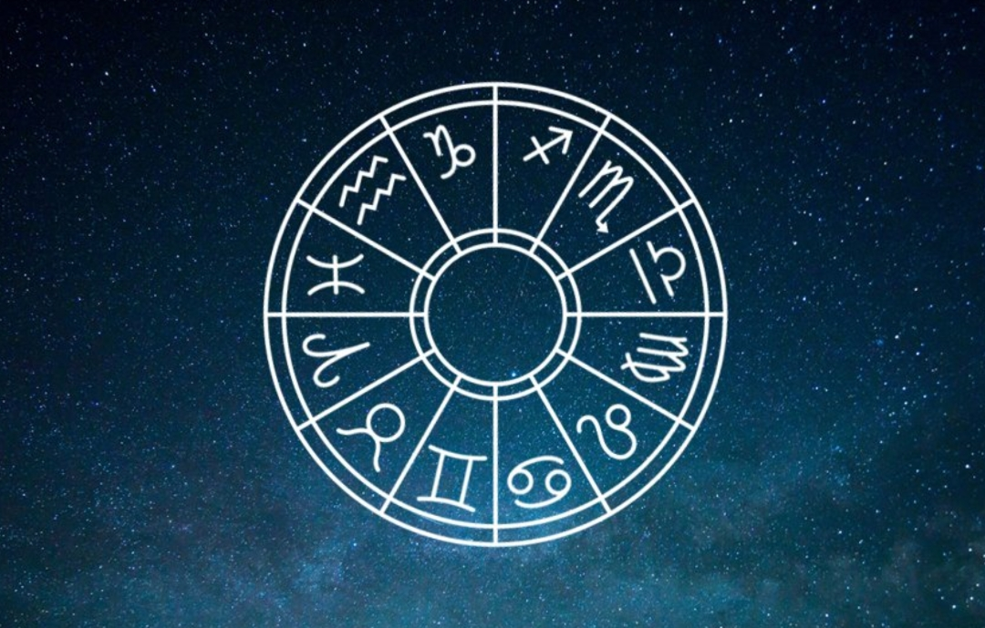
Astrological Predictions Systems

Slide 2
Astrology is the belief the positions of the stars and movements of the planets of the Solar System, and also asteroids and other stars, but not as much, have an influence on the events, lives, and behavior of people.
An astrologer looks at the planets' positions and tries to understand a person's character or tries to predict the future

Slide 3
HISTORY OF ASTROLOGY
Mesopotamia and the Babylonians: from 3000 BC
Astronomical observation begins with the early civilizations of Mesopotamia, where prominent constellations (the patterns formed by stars in the galaxy) are recognized and named soon after 3000 BC. Similary the sky-watchers of Mesopotamia identify the five wandering stars, which with the sun and moon form the seven original 'planets' Within Mesopotamia the Babylonians , flourishing from the 18th century BC, are the first great astronomers. The minutes and seconds of modern astronomical measurement derive from their number system .

Slide 4
The Greeks: from the 6th century BC
The Greeks make significant advances in the fields of both astronomy and astrology. In astronomy their analytical approach to the heavens leads to early insights of great brilliance, even though they eventually blind European astronomers for more than a millennium with the elaborately observed but entirely false Ptolemaic System Meanwhile astrology benefits from the range and vitality of the Greek gods. Linked with the planets and constellations, these very human divinities make astrology dramatic and exciting. And Greek interest in the individual extends the astrologers' range. Evolved originally to help in affairs of state, the art finds its lasting role in casting the fortunes of ordinary men and women

Slide 5
India and elsewhere: from the 1st millennium BC
India has had its own system of astrology from perhaps as early as 1000 BC. With Greek influence, during the Hellenistic period , the western version of the zodiac is introduced.
The same pattern recurs elsewhere at other periods of history. The spread of Arabic Scholarship , bringing forgotten Greek texts to medieval Europe, results in much work for the astrologers - until the Age of Science and the Age of Reason somewhat reduce the appeal of the ancient art. In most parts of the world astrology is thriving again in the 20th century. In countries such as India it has never lost its appeal. No important step in life can be safely undertaken unless the signs are propitious. No marriage will go ahead without horoscopes

Slide 6
Horoscope a description of people’s characters and the things that will happen to them, based on the position of the stars and planets at the time of their birth especially a description that is printed in a newspaper or magazine
The signs of the zodiac :- The twelve signs that you can belong to according to your birth date and the position of the stars then, which some people believe influence our characters and our lives

Slide 7
Aries :- The first sign of the zodiac, which is represented by a ram. People born between March 21 and April 20 belong to this sign.
Taurus :- The second sign of the zodiac, represented by a bull. People born between April 21 and May 21 belong to this sign.
Gemini :- The third sign of the zodiac, represented by twins. People born between May 22 and June 21 belong to this sign.
Cancer :- The fourth sign of the zodiac, represented by a crab. People born between June 22 and July 23 belong to this sign.
Leo :- The fifth sign of the zodiac, represented by a lion. People born between July 24 and August 23 belong to this sign.
Virgo :- The sixth sign of the zodiac, represented by a young woman. People born between August 24 and September 23 belong to this sign

Slide 8
Libra :- the seventh sign of the zodiac, represented by a pair of Scales. People born between September 24 and October 23 belong to this sign.
Scorpio :- the eighth sign of the zodiac, represented by a scorpion. People born between October 24 and November 22 belong to this sign.
Sagittarius :- the ninth sign of the zodiac, represented by an animal that is half horse and half human, carrying a bow and arrow. People born between November 23 and December 21 belong to this sign.
Capricorn :- the tenth sign of the zodiac, represented by a goat. People born between December 22 and January 20 belong to this sign.
Aquarius :- the 11th sign of the zodiac, represented by a man carrying water. People born between January 21 and February 19 belong to this sign.
Pisces :- the 12th sign of the zodiac, represented by a pair of fish. People born between February 20 and March 20 belong to this sign.

Slide 9
Thank you…

